Slide 1
ALOHA Packet System With And Without Slots And Capture
Gediminas Viliunas

Slide 2
Introduction
The ALOHA packet system was first described by Norman Abramson.
ALOHA uses a single broadcast channel shared by multiple devices.
It introduced a new method of packet-based communication, allowing independent transmissions.

Slide 3
Basics of ALOHA Packet System
Each device transmits a packet at random times.
If an acknowledgment is not received, a collision is assumed.
The packet is then retransmitted after a random delay.

Slide 4

Capture
FM receivers can track the strongest signal when multiple signals collide
Factors affecting capture:
Distance
Random individual power variations
Capture Ratio $CR=10\log{\frac{p_{2}}{p_{1}}} ;p_{1}>p_{2}$
Distance Factor $r_{1}^{2}=βr_{2}^{2};β^{\frac{1}{2}}=\frac{r_{1}}{r_{2}}$
Notes:
This is determined by the capture ratio (1.5 - 3 dB).

Slide 5

Definitions
$γ$ → The total bit rate being transmitted by all stations as a fraction of the total bandwidth
$σ$ → The actual bit rate being received correctly
$q$ → Probability of a packet being received correctly
Notes:
$$σ=γq$$

Slide 6

Probability of no conflict
All stations start packets at random time with the rate:
$$λ=\frac{γ}{T}$$
Probability of no conflict within time
$$q_{0}=e^{−γm}$$
Notes:
Poisson Point Process

Slide 7
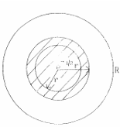

Interfering stations
Interfering stations are within area , while the total area is
$$πR^{2}$$
Fraction of conflict-causing stations
$$k=\frac{r^{2}}{R^{2}}$$
Thus, the stations which would cause conflict is the area ratio
$$q(r)=e^{−γkm}$$

Slide 8

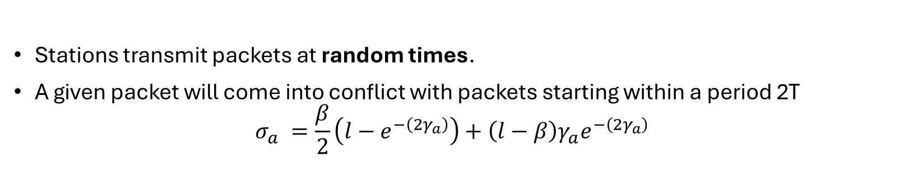
Asynchronous Slots
Stations transmit packets at random times.
A given packet will come into conflict with packets starting within a period 2T
$$σ_{a} =\frac{β}{2}\left(l−e^{−\left(2γ_{a}\right)}\right)+\left(l−β\right)γ_{a}e^{−\left({2γ}_{a}\right)}$$

Slide 9

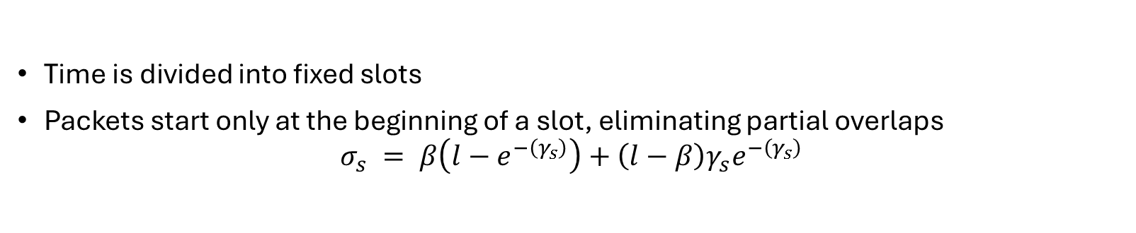
Synchronous Slots
Time is divided into fixed slots
Packets start only at the beginning of a slot, eliminating partial overlaps
$$σ_{s} = β\left(l−e^{−\left(γ_{s}\right)}\right)+\left(l−β\right)γ_{s}e^{−\left(γ_{s}\right)}$$

Slide 10


Maximum $σ$ for Slots
Except for the unrealizable case capture ratio $β=0$ in which the maximum$,σ=1 at γ=∞$
$$σ_{max}=β+\left(l−β\right)e^{−(γ_{q})}$$
were
$$γ_{1}=\frac{l}{l−β}$$

Slide 11

Delay
Initially the channel and packet transmission delay assuming no conflict
Retransmissions occur, each takes some time R from transmission to subsequent retransmission
The total delay is:
$$D=A+R(\frac{γ}{σ}−l)$$

Slide 12
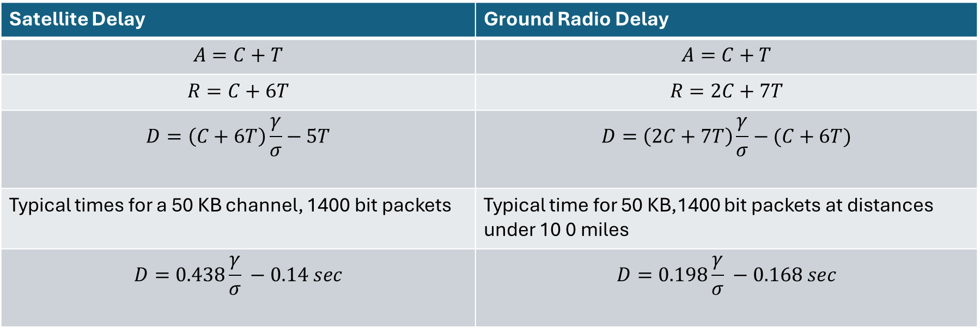
Delay
Satellite Delay | Ground Radio Delay
$$A=C+T$$ | $$A=C+T$$
$$R=C+6T$$ | $$R=2C+7T$$
$$D=\left(C+6T\right)\frac{γ}{σ}−5T$$ | $$D=\left(2C+7T\right)\frac{γ}{σ}−(C+6T)$$
Typical times for a 50 KB channel, 1400 bit packets | Typical time for 50 KB,1400 bit packets at distances under 10 0 miles
$$D=0.438\frac{γ}{σ} −0.14 sec$$ | $$D=0.198\frac{γ}{σ} −0.168 sec$$

Slide 13

Operating point
A system becomes unstable when approaches maximum throughput
An operating point must he chosen below the maximum $σ$ point, which is dynamically stable and has a reasonable delay
Convenient to pick point where operating point has such properties
$$q=\frac{l}{2};γ=2σ$$

Slide 14
Conclusion
For satellite use, slots will improve the capacity by a factor of two
For ground radio, a good FM receiver would permit a further improvement to 60% of the full bandwidth .
Slots clearly need not be used at very low channel utilizations since the asynchronous system will work just a s well at low rates .

